Slide 1

SRM INSTITUTE OF SCIENCE AND TECHNOLOGY
SCHOOL OF COMPUTING
DEPARTMENT OF NETWORKING AND COMMUNICATIONS
18CSP107L / 18CSP108L MINOR PROJECT / INTERNSHIP
28/09/2024
AI-based Financial Advisor for Stock Market Predictions with Cloud-Integration
Guide Name: Student Name & Registration Number:
Mrs. Vijayalakshmi V Rachit Sood [RA2111028010110]
Assistant Professor Papai Mondal [RA2111028010116]
NWC Asmi Shrivastava [RA2111028010119]

Slide 2
Table of Contents
Abstract
Introduction
Problem Statement
Literature Survey
Objectives
Architecture Diagram
User Story
Implementation and Result
Conclusion
References

Slide 3
Abstract
The research aims to enhance AI-based personal finance advisors for stock market investments by addressing critical challenges identified in existing systems. The objectives include improving algorithmic flexibility, bolstering data security, and mitigating algorithmic bias to ensure fair and equitable recommendations. The study also focuses on increasing transparency and explainability of AI models, aligning them with regulatory standards to build investor trust, and integrating behavioural finance insights to capture investor sentiments more accurately. Through these advancements, the research seeks to create a more reliable, secure, and user-centric AI-driven financial advisory system.

Slide 4
Introduction
Investing in the stock market is complex, with constantly changing prices and global events affecting market conditions. Traditionally, financial consultants have provided advice, but their services are expensive and inaccessible for many.
The integration of AI, has enhanced real-time analysis of large datasets, improving prediction accuracy and personalized advice. Combining AI with cloud computing offers scalability and provide secure, real-time financial advisory services.
With advancements in technology, Artificial Intelligence (AI) and machine learning (ML) are transforming financial advisory services. Early systems analysed stock trends but lacked accuracy and personalized recommendations.
With the use of AI for stock market investments we utilize cloud computing to address challenges like bias, data security, and scalability.

Slide 5
Problem Statement
According to our research, stock market presents significant challenges due to unpredictable and volatile nature of stock prices.
Although AI-based financial advisory systems have emerged to provide automated investment recommendations, they often face limitations in scalability, real-time data processing, and prediction accuracy.
Moreover, issues such as data security, algorithmic bias, and transparency remain unresolved in many AI models, preventing widespread adoption.
Our project focuses on using cloud computing to build a reliable, secure, and scalable AI financial advisor that addresses these challenges for stock market investments.

Slide 6
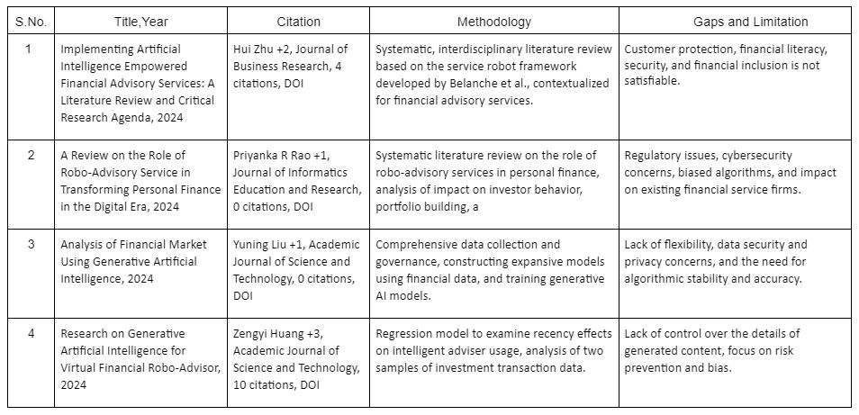
Literature Survey

Slide 7
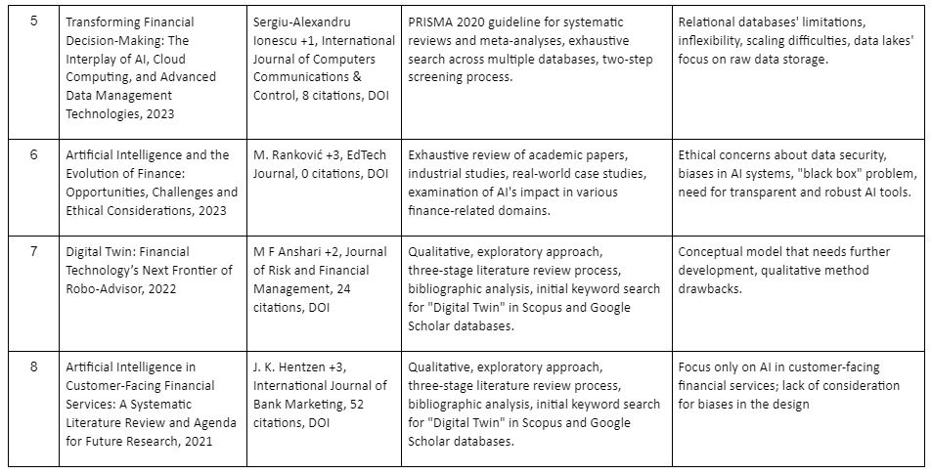

Slide 8
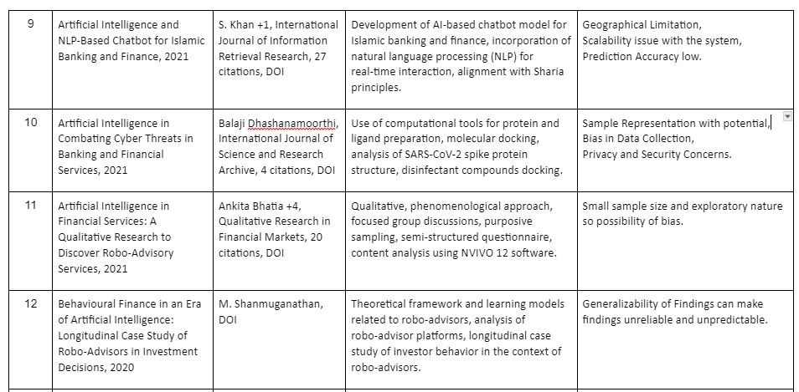

Slide 9
Objective
To develop cloud-based dashboards and to leverage the scalability of cloud computing to efficiently handle large-scale data processing and complex computations required for real-time stock market analysis and to provide investment recommendations.

Slide 10
Methodology
This research develops an AI-based personal finance advisor to provide real-time stock market predictions. First, historical stock market data is collected and preprocessed to ensure data quality. Various models, including traditional time series models (e.g., ARIMA, Holt-Winters) and machine learning models (e.g., Random Forest, Gradient Boosting), are trained using cloud-based platforms to leverage scalability. The models are then evaluated using accuracy metrics like SMAPE and RMSE to select the best-performing model. The model is deployed on Streamlit Cloud for real-time user interaction, allowing users to input stock symbols and receive predictions. The results are cumulated to create a comparative study of all the algorithms implemented.

Slide 11
Modules
The methodology involves the development and deployment of an AI-driven financial advisory system that predicts stock market trends and provides investment recommendations using various forecasting models and cloud computing for scalability. The system comprises several modules:
1. Data Collection:
Gathered historical stock market data, including stock prices, volumes, and relevant financial indicators using Yahoo Finance dataset.
2. Data Preprocessing:
Cleaned and preprocessed the raw data by handling missing values, outliers, and normalizing the data.
Extracted useful features such as moving averages, volatility, and other technical indicators that influence stock prices.
3. Model Development:
Trained a variety of time series forecasting models, including ARIMA, Holt-Winters, and Simple Exponential Smoothing (SES), to capture historical trends.
Implemented machine learning models like Random Forest and Gradient Boosting to analyze non-linear patterns and make predictions.

Slide 12
4. Model Evaluation and Selection:
Evaluated the accuracy of each model using metrics such as SMAPE (Symmetric Mean Absolute Percentage Error) and RMSE (Root Mean Square Error).
Compared traditional models with machine learning models to determine the most accurate model for predicting stock prices.
5. Cloud-Based Deployment:
Deployed the selected model on Streamlit Cloud, providing a user-friendly interface for interacting with the AI-based advisor while also handling the large dataset.
Integrated real-time data feeds to enable continuous updates and predictions.
7. Bias Mitigation :
Ensured that the system offers clear explanations for investment advice, helping users make informed decisions by a comparative study of all the algorithms that are implemented.

Slide 13
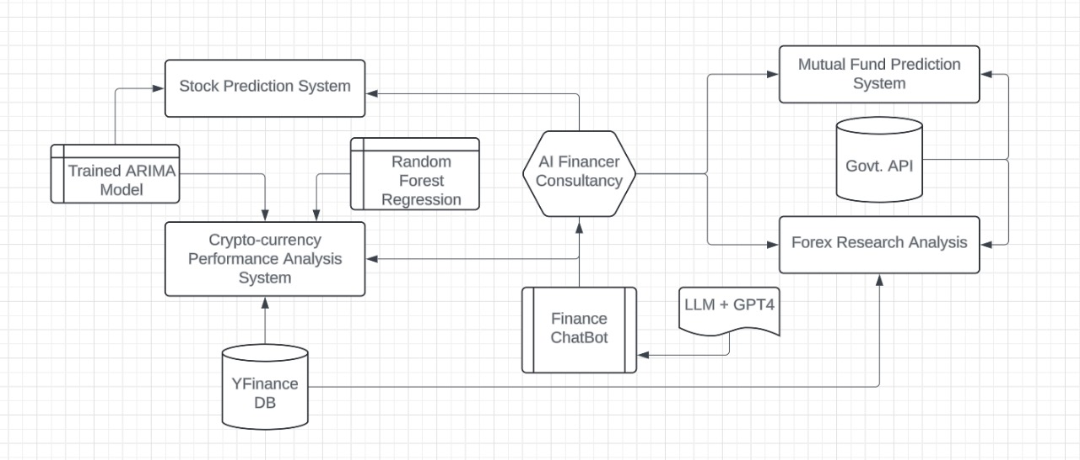
Architecture

Slide 14
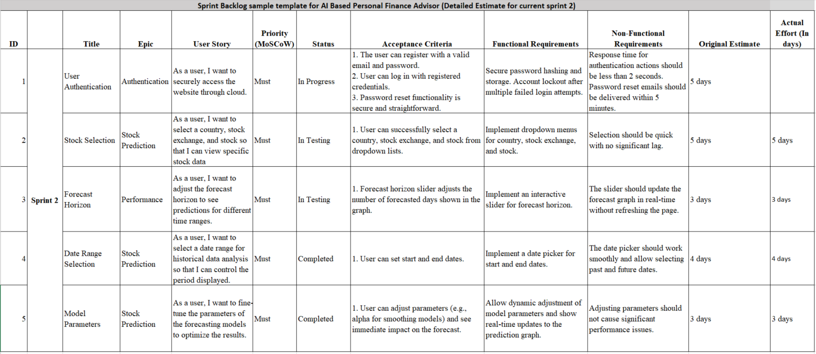
User Story

Slide 15
Implementation
For sprint 2, we have implemented the following:
Step 1: We have successfully created a homepage for the system and created hyperlinks to the stock predictions page.
Step 2: In the predictions page, we have implemented AI models like the ARIMA along with options to choosing stocks, start and end date, intervals and periods.
Step 3: After selecting our necessary required conditions the prediction system provides us with a visualization in the form of a graph of current and upcoming trends.

Slide 16
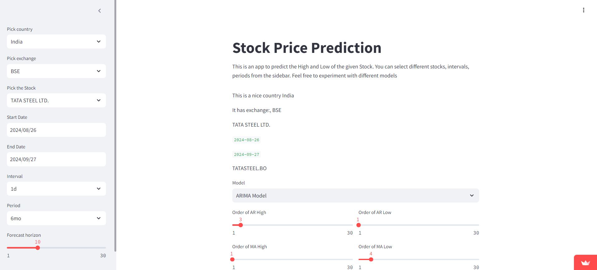

Slide 17
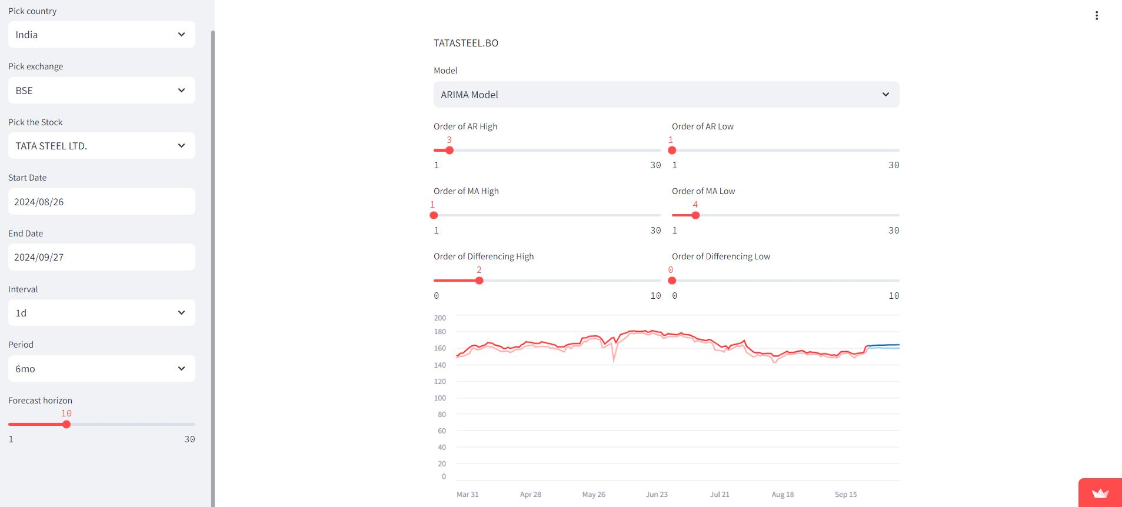

Slide 18
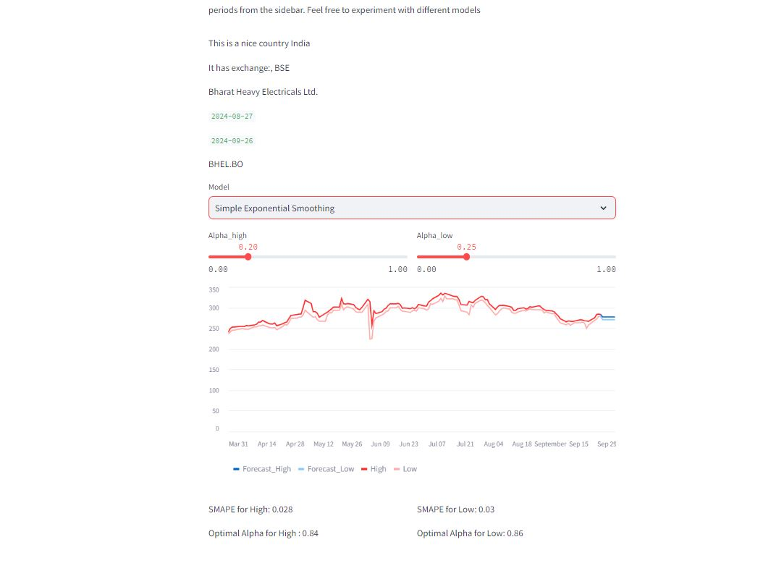
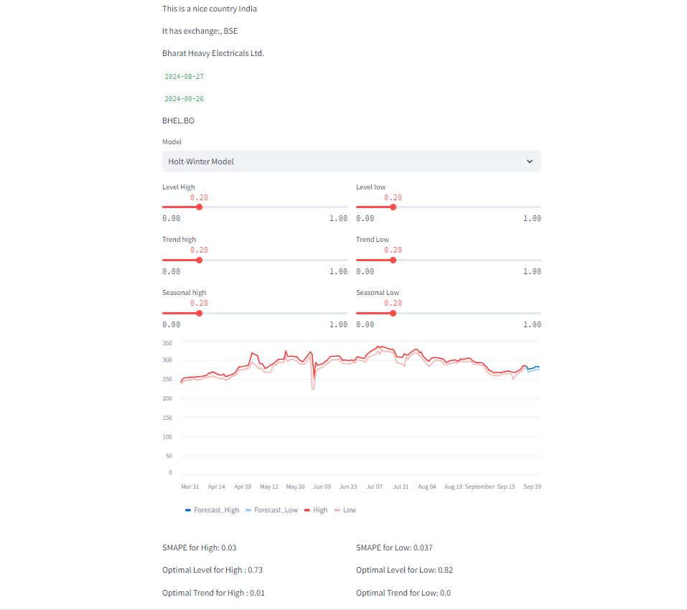

Slide 19
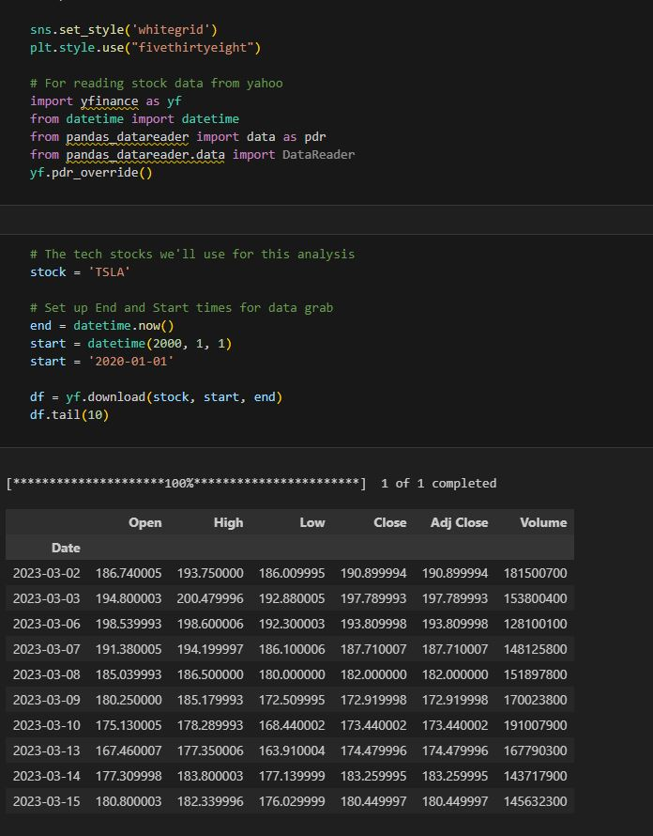
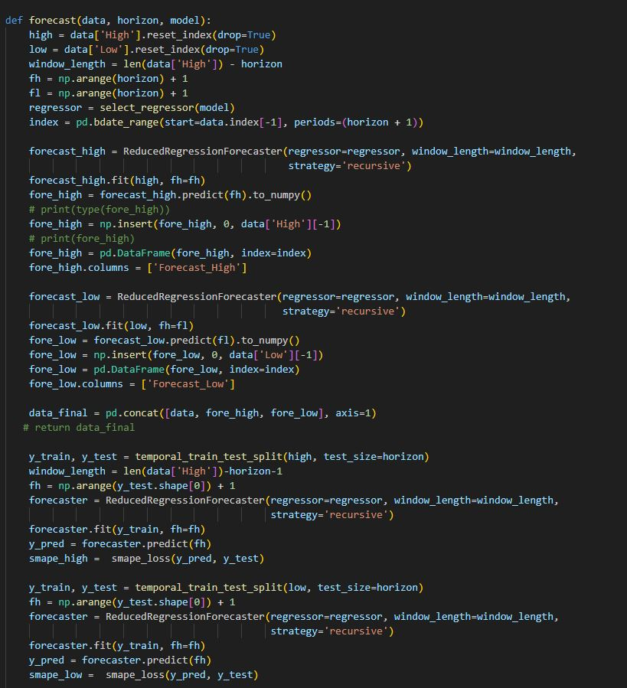

Slide 20
Result
For Sprint 2, in terms of forecasting accuracy, the ARIMA model demonstrates significant improvements over both the Simple Exponential Smoothing (SES) and Holt-Winters models. When compared to SES, ARIMA shows a 35.71% improvement in accuracy for high predictions and a 30% improvement for low predictions. Similarly, ARIMA outperforms the Holt-Winters model with a 40% improvement for high predictions and a 43.24% improvement for low predictions.

Slide 21
Conclusion
This research develops an AI-based personal finance advisor focused on stock market investments, utilizing cloud computing to enhance performance, scalability, and real-time decision-making. The system tackles key challenges like data security, algorithmic bias, and transparency, ensuring that users receive reliable and personalized financial advice. By integrating advanced AI models and cloud infrastructure, the solution makes investment guidance more accessible, affordable, and accurate.
Future improvements will focus on refining prediction models, expanding global market data, and continuously optimizing for fairness and compliance.

Slide 22
References
[1] Implementing artificial intelligence empowered financial advisory services: A literature review and critical research agenda Hui Zhu , Olli Vigren , Inga-Lill Soderberg, Journal of Business Research Volume 174 , March 2024, 114494.
[2] A Review on the role of Robo - advisory service in transforming Personal Finance in the Digital - Era Priyanka R Rao,Dr. K.S. Lakshmi, Journal of Informatics Education and Research Volume 4, 2024, 1526-4726.
[3] Analysis of Financial Market using Generative Artificial Intelligence Yuning Liu1, Junliang Wang2, Academic Journal of Science and Technology ,Volume 11, 2024, 2771-3032.
[4] Research on Generative Artificial Intelligence for Virtual Financial Robo‐Advisor Zengyi Huang1, Chang Che2, Haotian Zheng3, Chen Li4,Academic Journal of Science and Technology, Volume 10, 2024, 2771-3032.
[5] Transforming Financial Decision-Making: The Interplay of AI, Cloud Computing and Advanced Data Management Technologies, Sergiu-Alexandru Ionescu, Vlad Diaconita, Journal of Computers Communications & Control Volume 18,December 2023, ISSN 1841-9844, ISSN-L 1841-9836.
[6] Artificial intelligence in customer-facing financial services: a systematic literature review and agenda for future research, J. K. Hentzen, A. Hoffmann, Rebecca Dolan, Erol Pala, International Journal of Bank Marketing, 2021, 0265-2323.

